Slide 1
C# Project: Spider Solitaire
19011561 이승규

Slide 2
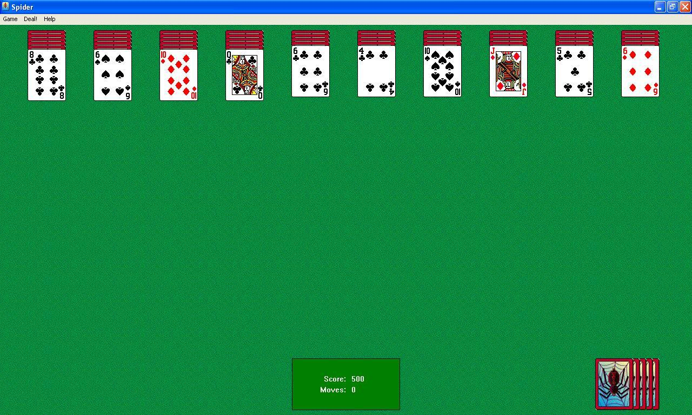
Game introduction
Classic game in Windows XP
Uses Playing cards

Slide 3
How to win
Make 13 cards back straight to erase.
If table is empty, you win
Score = 500 – (moves)

Slide 4
How I implemented
Conditions
: Game starts with 54 cards dealt (First 4 columns have 6, others 5 cards)
: card can only move to +1 number card
: can move card to +1 number and different shape
: cannot select stack with different shapes
Game
Card
CardTable
Deck
Form

Slide 5
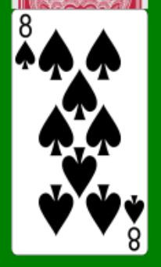
Card Class
Card
Shape, Number. Column, isClicked, isHidden
CardClick()
Move()
Reveal()

Slide 6
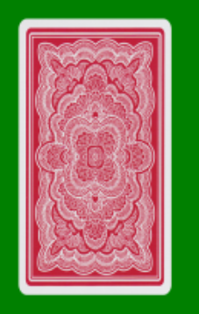
Deck Class
Deck
Draw()
: put 1 card from deck
Deal()
: distribute to each stack

Slide 7

CardTable Class
CardTable
tableClick()
: move cards to empty stack

Slide 8
Form Class
Form
update()
: synchronize view with data
Popups,
Labels

Slide 9
Game Class
Game
initGame()
: shuffle cards according to level
checkFinish()
: check if a stack is finished

Slide 10
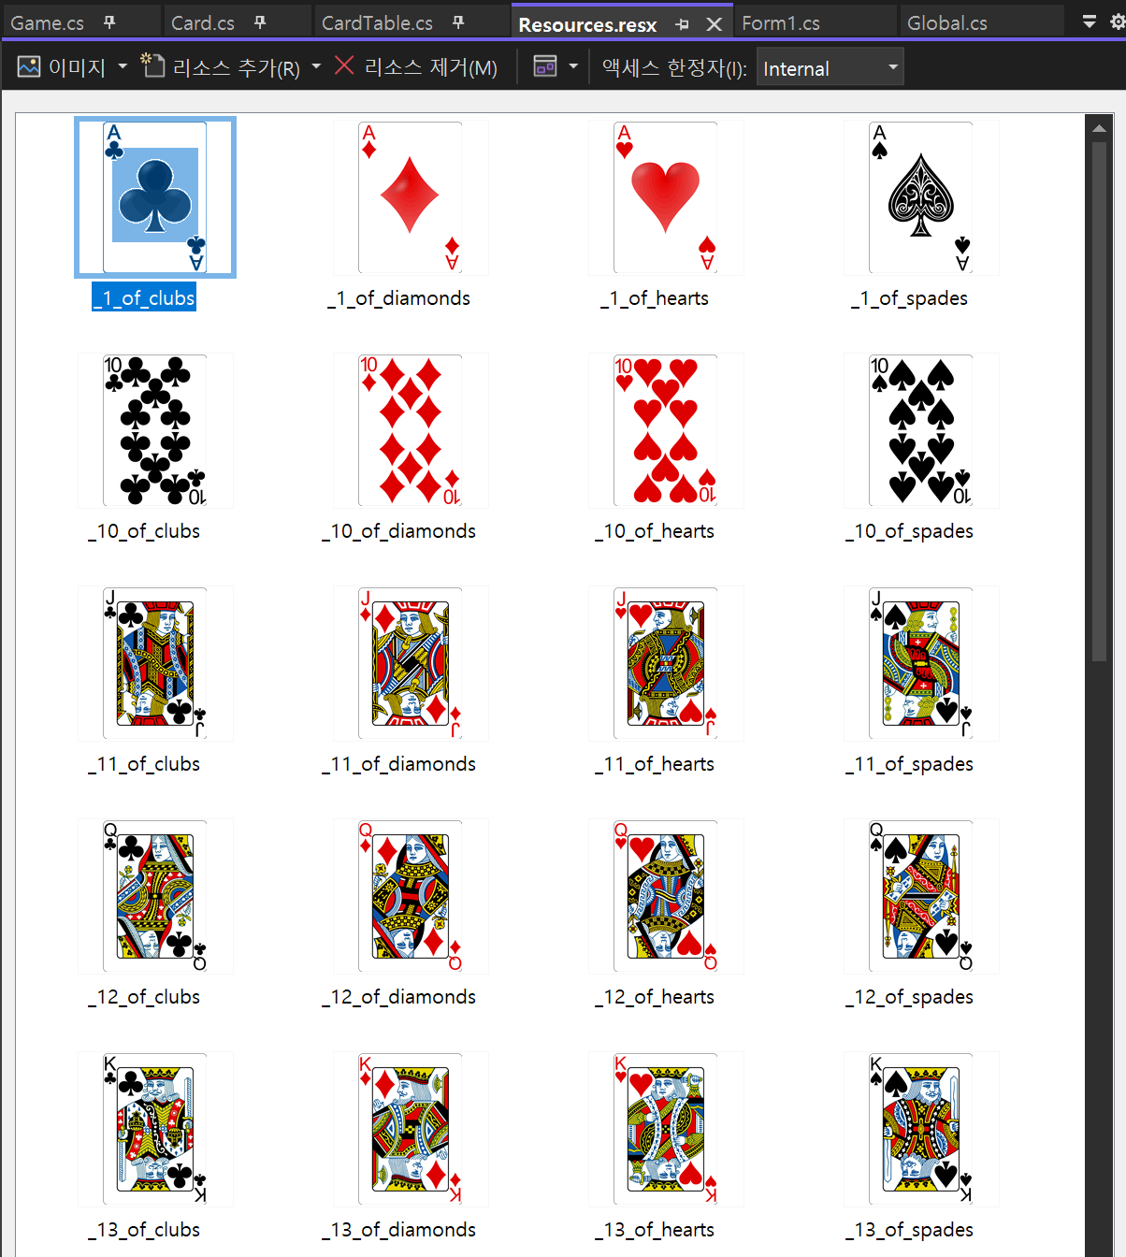
Global Variables
Clicked
stack
10
Stacks
Deck
Stack
score
Unsolved
Set number

Slide 11
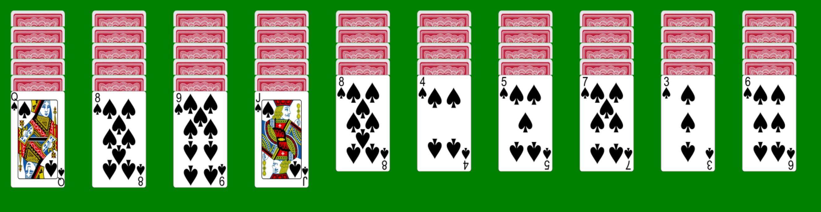
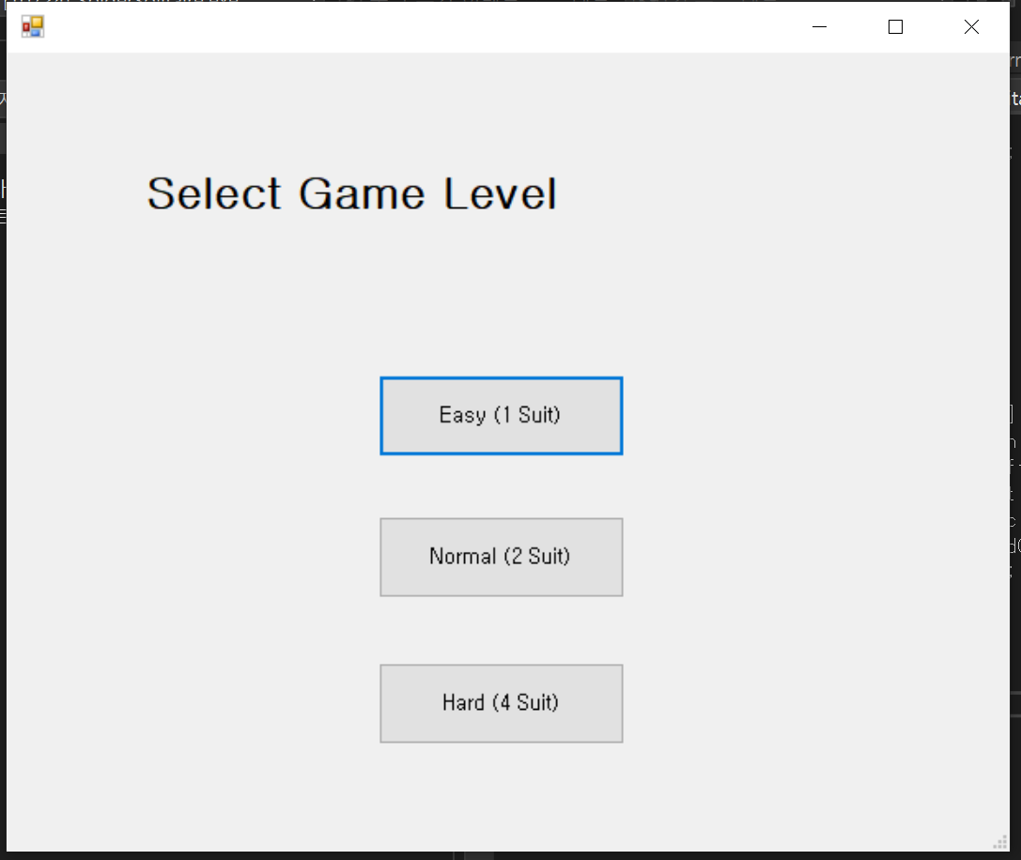
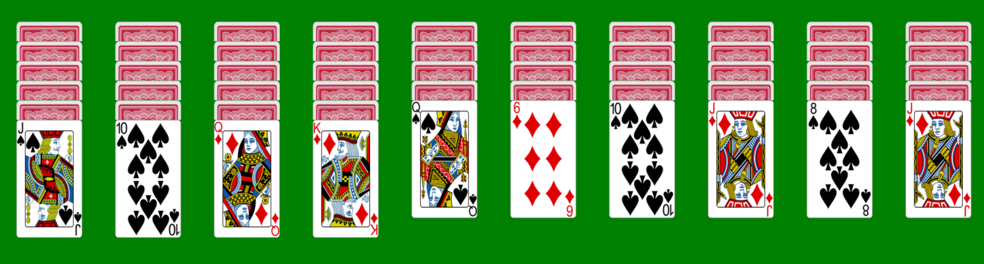
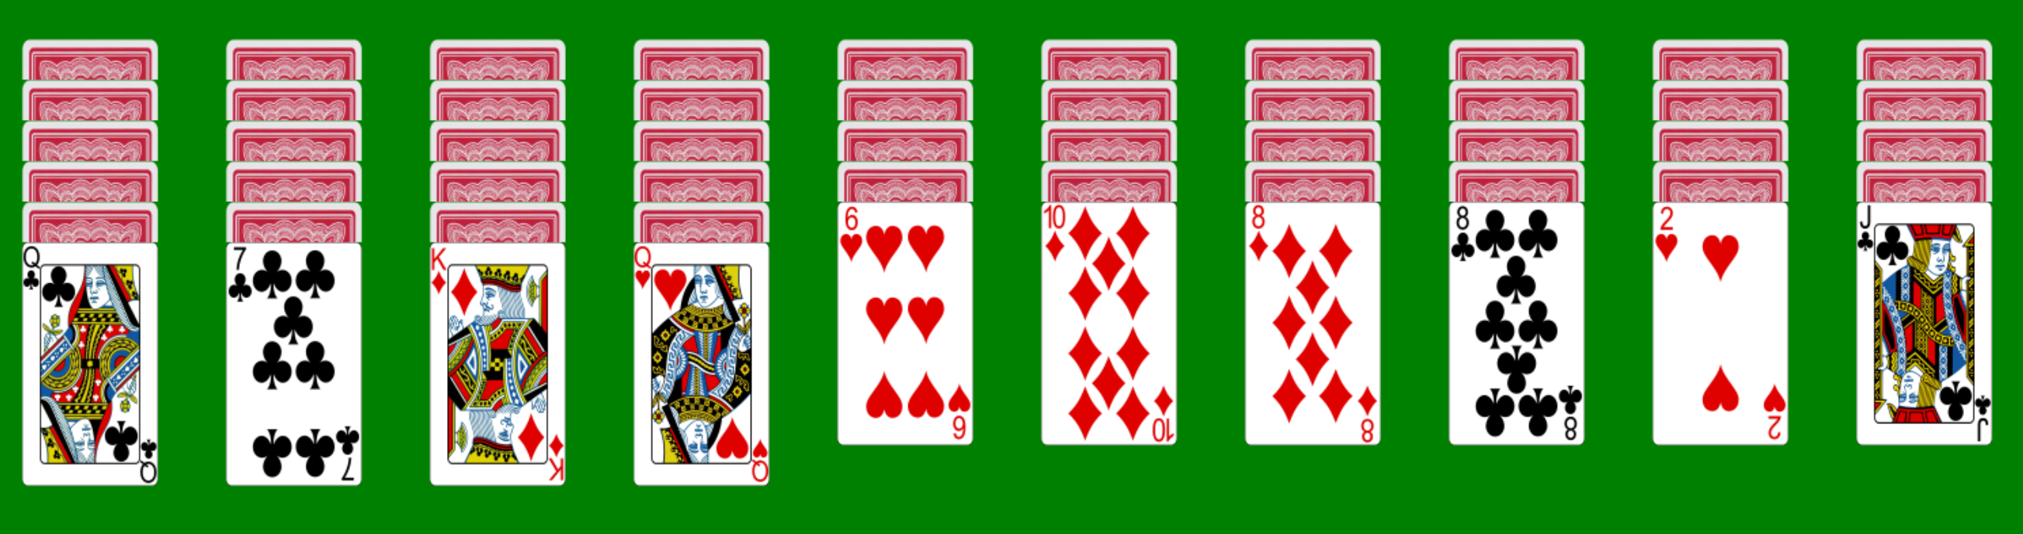
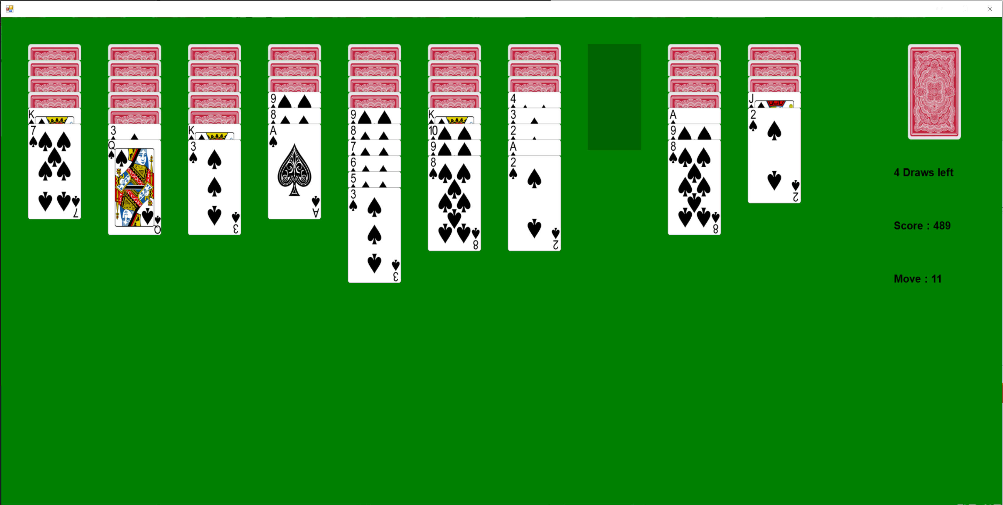
Gameplay
Only spade
Spade and Diamond
All suits

Slide 12
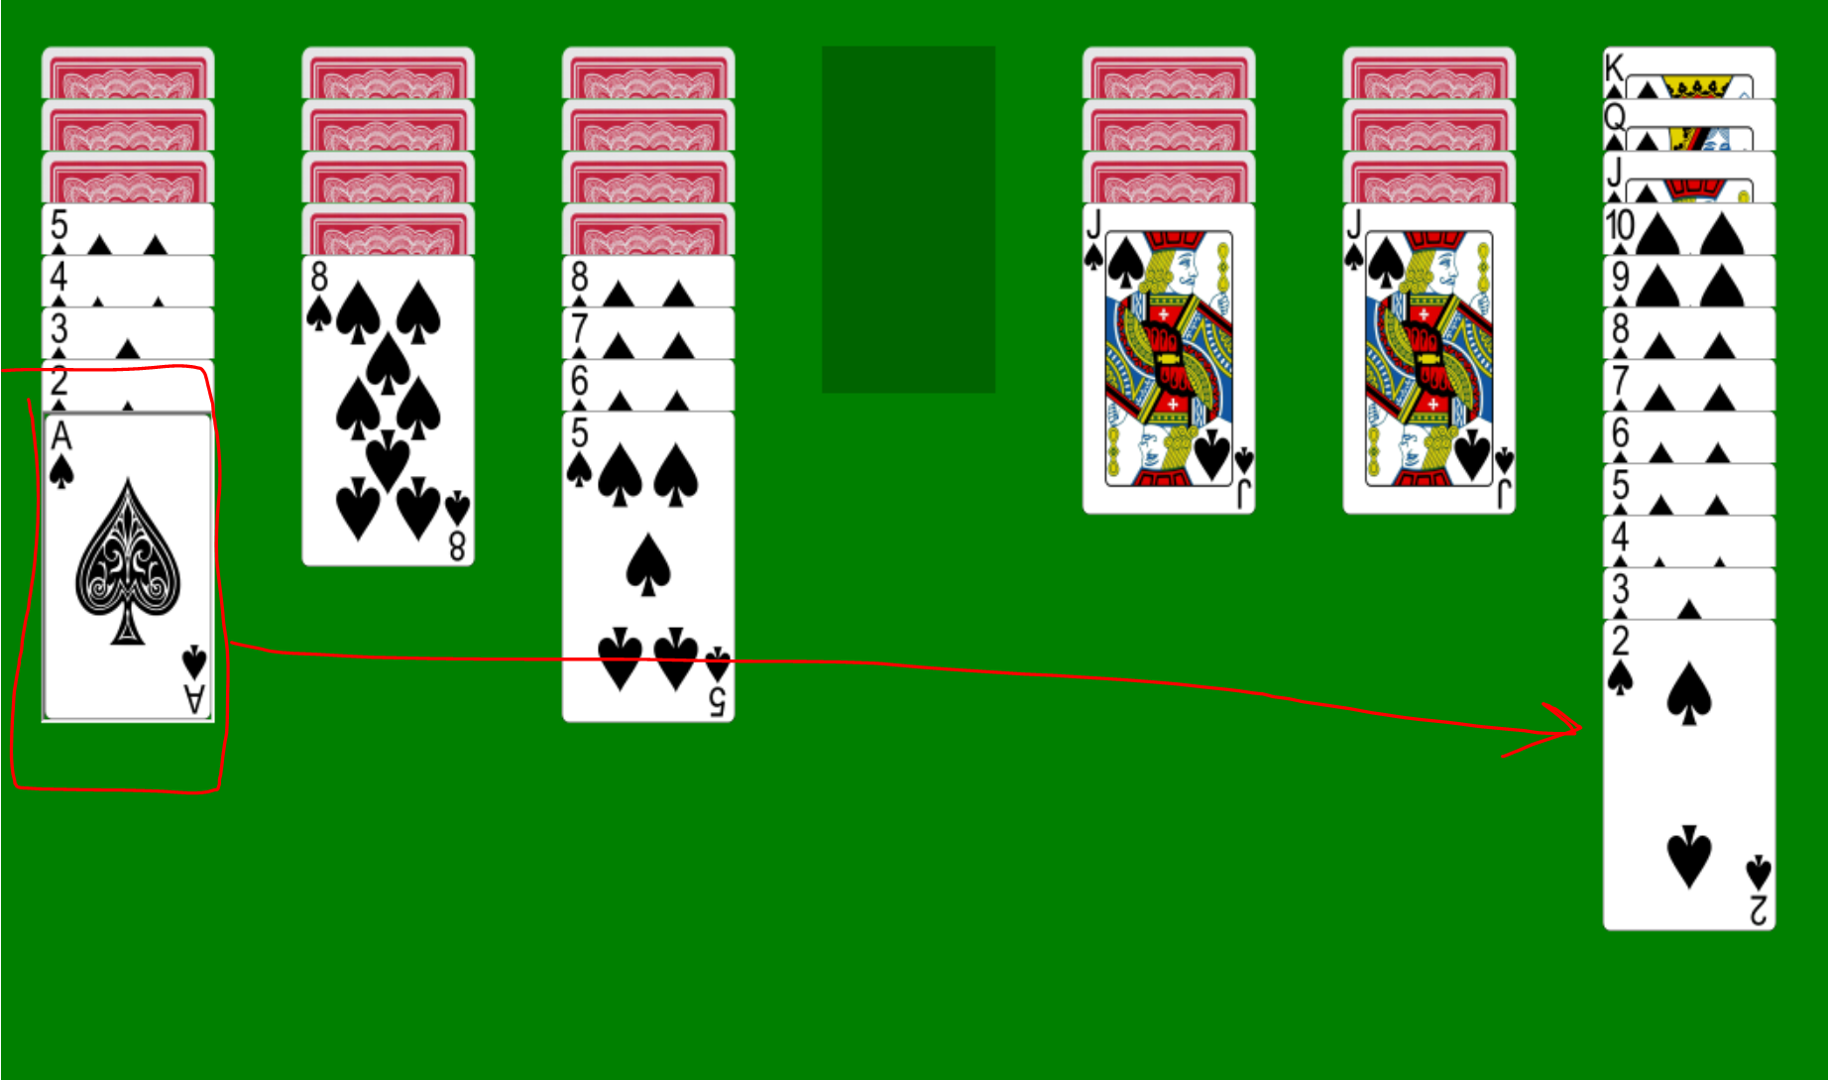
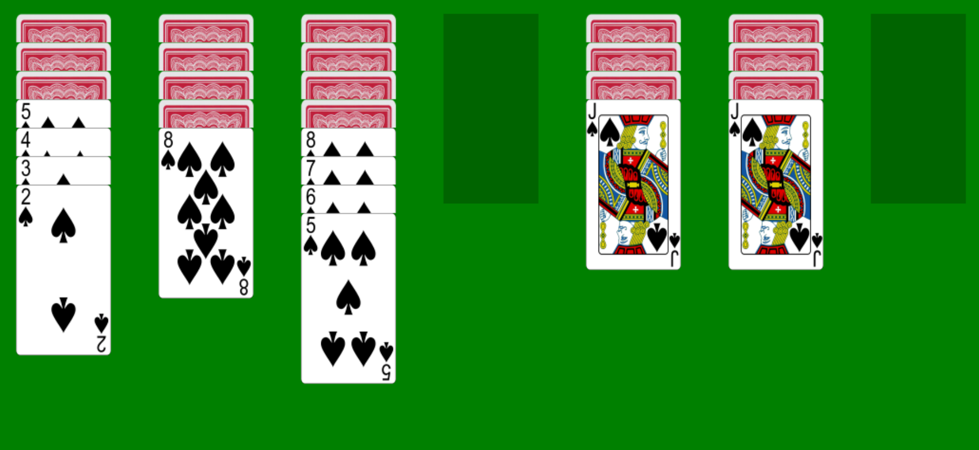
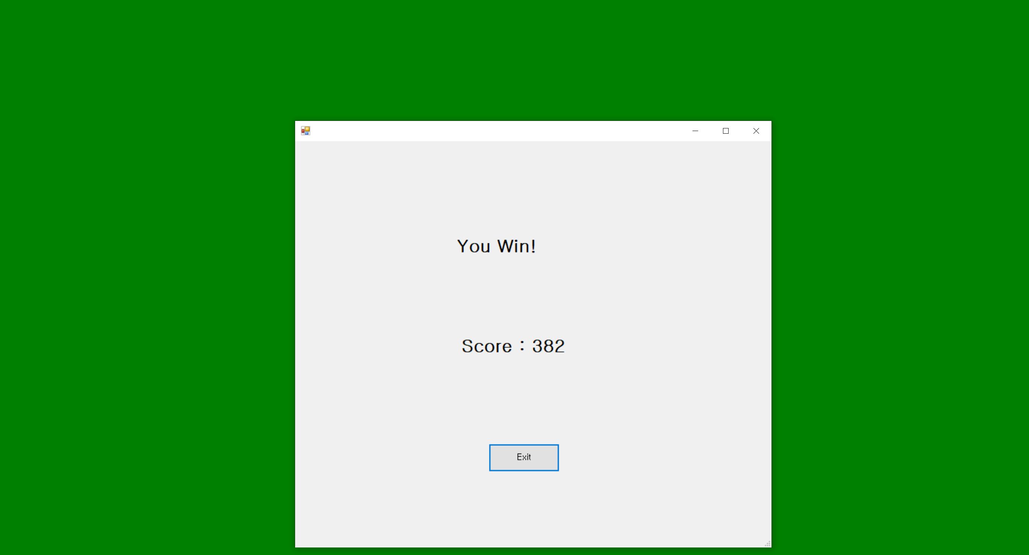
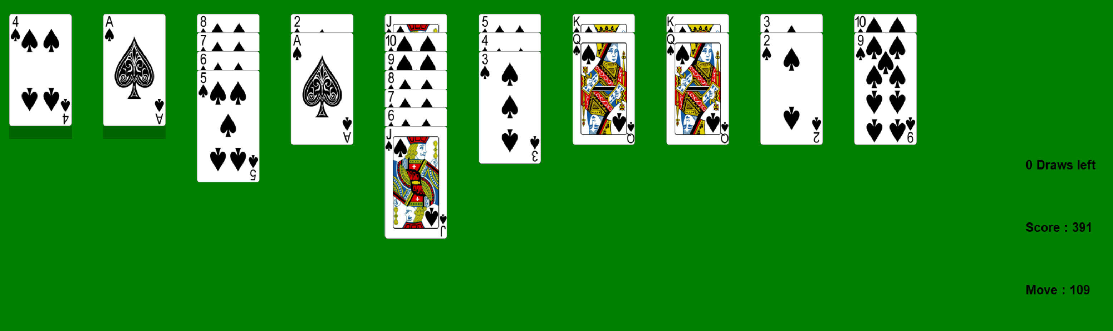
Game clear

Slide 13
Thank you

